Slide 1

ABC TELECOM WE SERVE YOU BETTER

Slide 2
PILLARS OF OUR PROJECT
(TEAM MEMBERS):
1.PRADEEPRAJ-(TEAM LEAD)
2.R SANGEEETHA
3.VARSHITHA
4.SWETHA DARUR
5.SURYA RAMYASHREE
6. PRAJWAL
7.POONAM KUMARI
8.PRASHANTA J N
9. RAJENDRA PRASAD
10.PRASHANT SHINDE
FRONTEND
BACKEND

Slide 3
ABSTRACT
The main Objective of our application is to store the data of COMPLAINT raised by our customer using our services, where we can add ,delete and update the status of the complaint using– CRUD operations .
In this Generation , management tool is very much needed to manage things in single application, which is more comfortable rather than using multiple application or else directly interacting with database.
In this we also add the feature of login purpose where only authorized users can only use our application .

Slide 4




Front end:
Angular
HTML,CSS
SERVER SIDE:
Spring Boot
BACK END:
MYSQL Hibernate
SERVER:
Tomcat
Technologies used

Slide 5


PROPOSED SYSTEM
The proposed system is specially for the customers who are facing issues while using telecom services.
In this system, the customer has to file the complaint and a ticket with unique ID will be generated and given to them.
This complaint will be assigned by the manager to the respective engineer with the respective PINCODES.
The customer can view the ticket status using their ticket IDs and one customer can also raise more than 1 ticket at a time.

Slide 6
Fast responses and tracking of complaints are useful for the customers to know their status. This reduces the waiting time of the customers to reach customer care.
The complaints will be redirected or assigned to the respective engineers by matching the customer’s and engineer’s pin code which is easy and flexible to use.
In future we can improve this application by adding more benefits to customers in order to solve the issues faced by them.
ADVANTAGES
&
FUTURE IMPROVEMENTS

Slide 7
ER-DIAGRAM
pincode
engr_ID
mgr_ID
mobile_no
pincode
mgr_name
Assigned to
Cust_name
ENGINEER
admin_name
MANAGER
mgr_ID
engr_name
mobile_no
Raised by
mobile_no
CUSTOMER
Carried by
ticket_ID
ADMIN
address
status
engr_ID
mobile_no
email
cust_ID
ticket_ID
complaint
TICKET
admin_ID

Slide 8
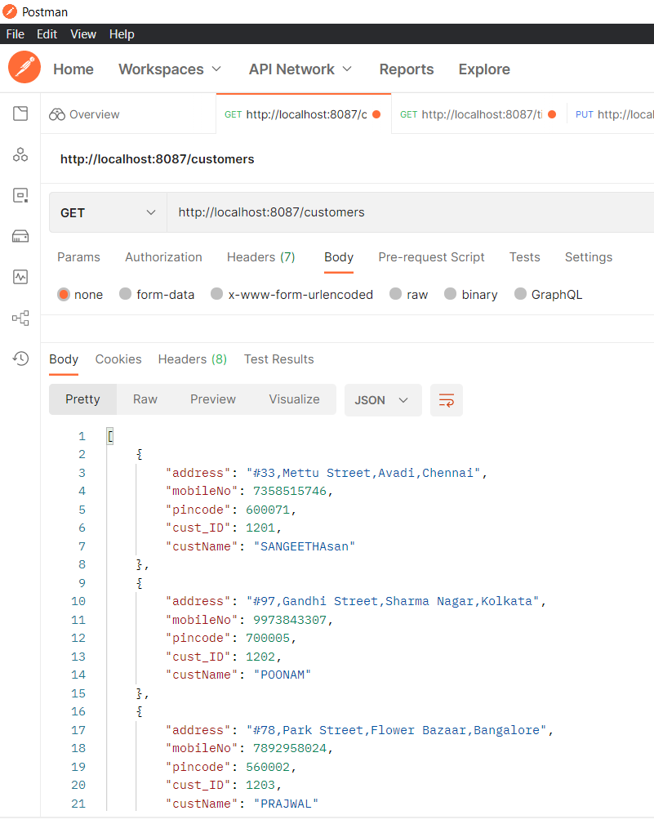
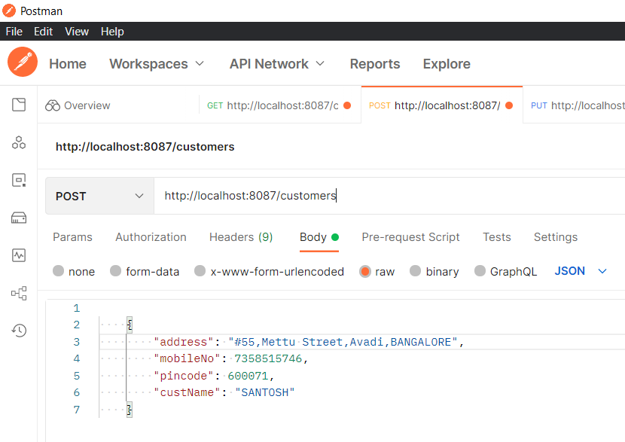
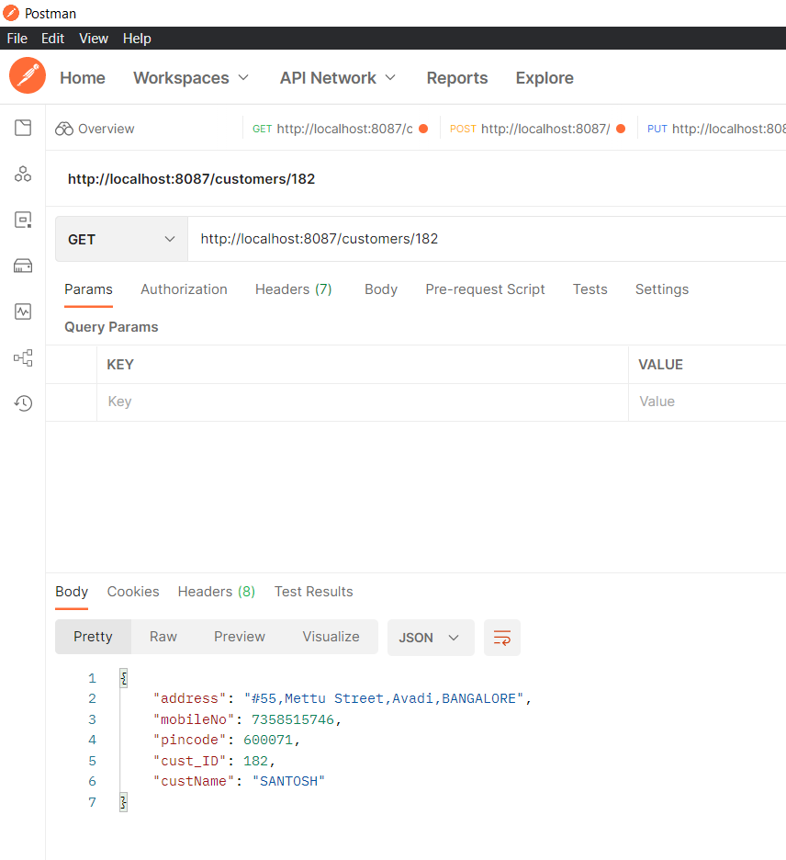
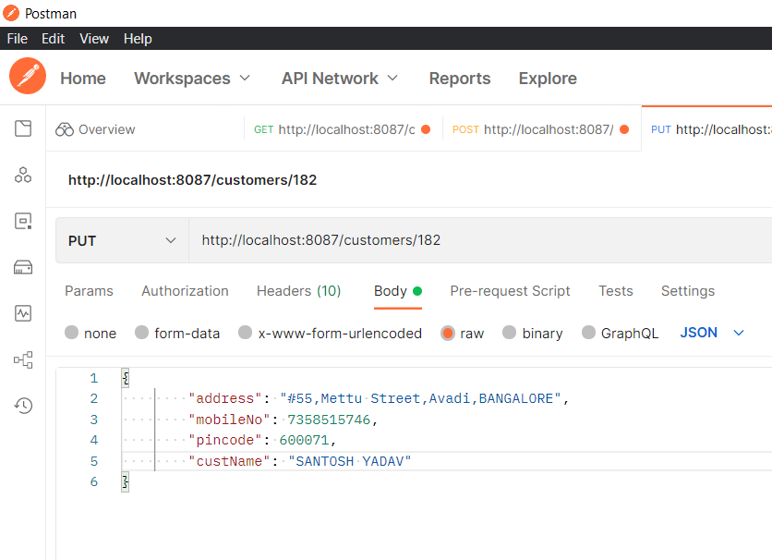
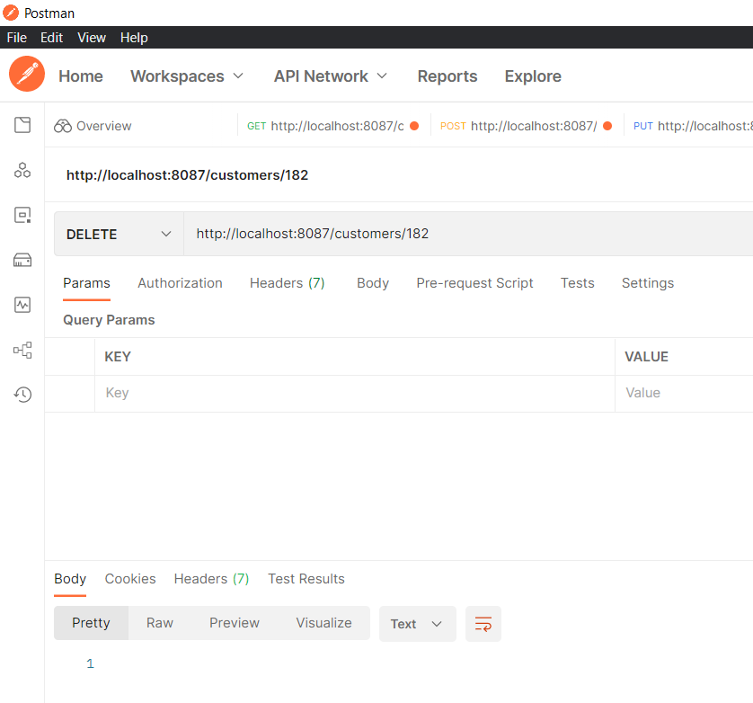
SAMPLE SCREENSDHOTS

Slide 9
THANK YOU

